Slide 1


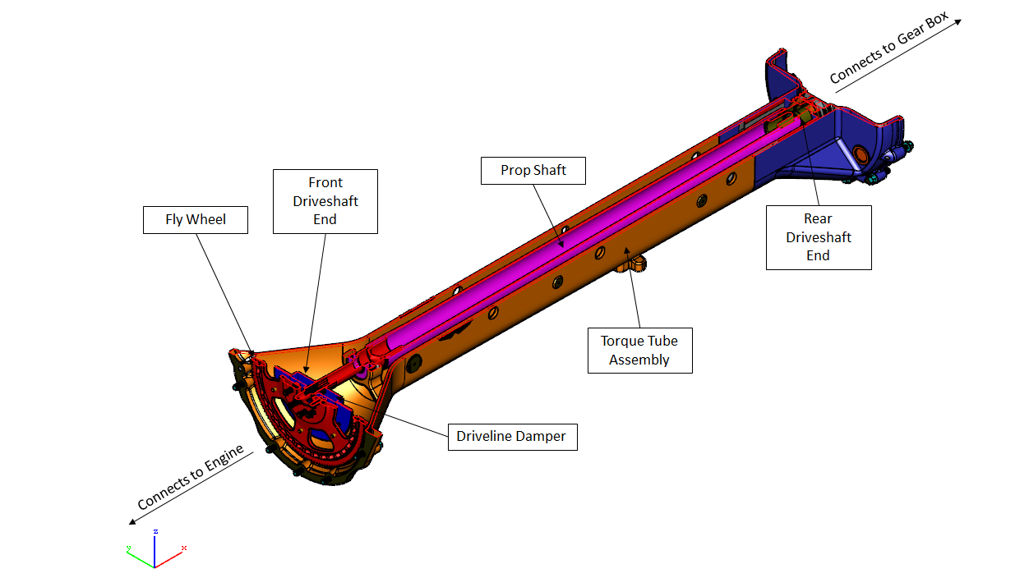
Brief
Noise Analysis
of Vibrations
in a Torque Tube

Slide 2
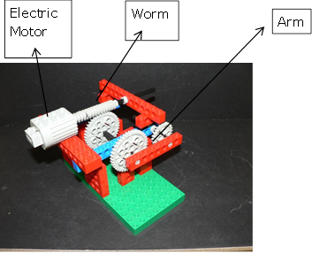
Modelling a windscreen wiper mechanism

Slide 3
We visited Aston Martin where the engineers explained how the drive from the engine was transferred from the engine through the torque tube to the gear box at the back of the car. We discussed how to create an imbalanced load on the proposed model and used lego to make a model of a windscreen wiper so that we could visualise this effect better.

Slide 4
At Birmingham University we were shown how vibrations could be created and measured. The lecturers also explained some of the complex testing they were undertaking on engines in order to analyse how to make them more efficient. We had great support to make the structure that we had drawn out so that we could then mount the torque tube on this when we returned to school.

Slide 5
Working Drawing of final structure

Slide 6
At school we then investigated other devices that could measure sound and vibration. Guitar pick-ups were considered but we discovered that they worked on the principle of electromagnetism and the torque tube is carbon fibre.
We found a company called Gracey and Associates who suggested using their B&K 2250 Vibration Analysis Meter.

Slide 7
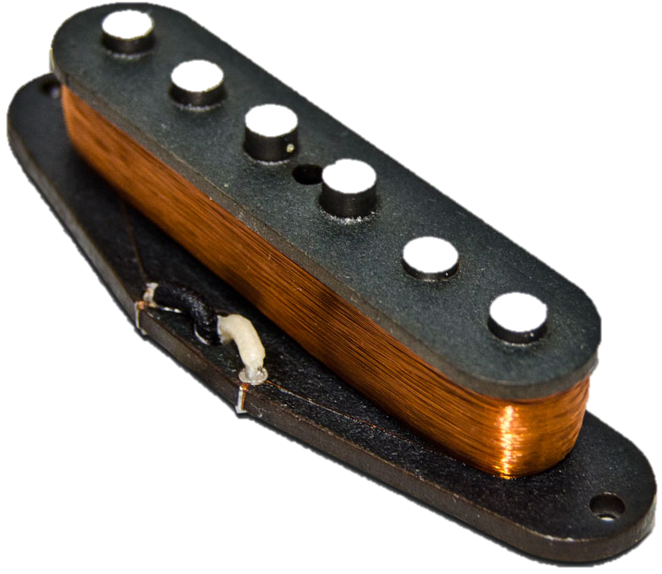
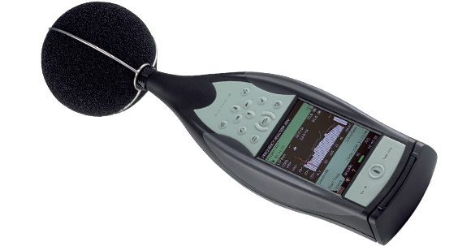
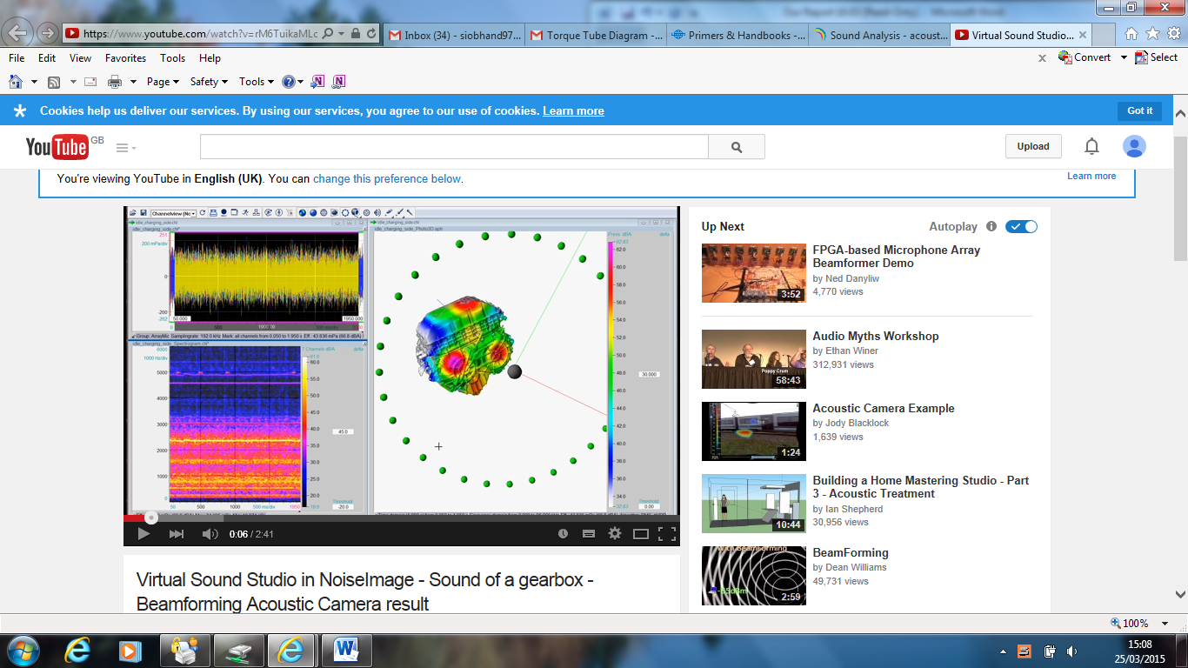
Guitar Pickup
Sound Level Meter - Type 2250
Images made using a acoustic camera

Slide 8
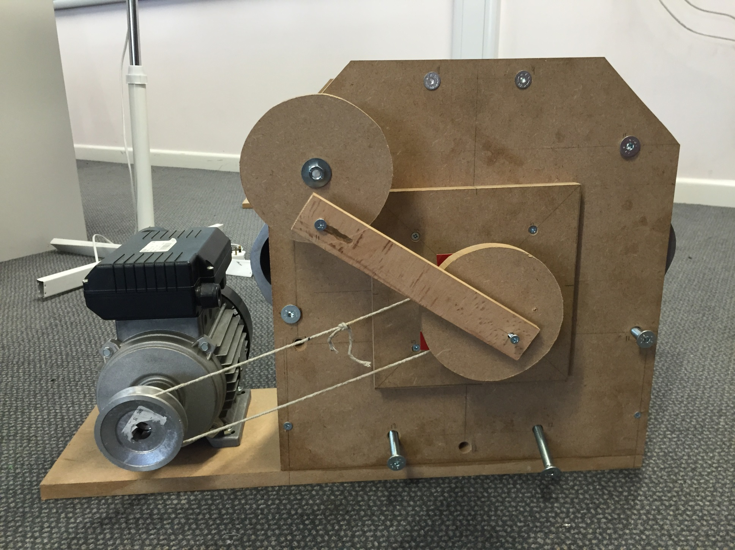
Final Mechanism

Slide 9
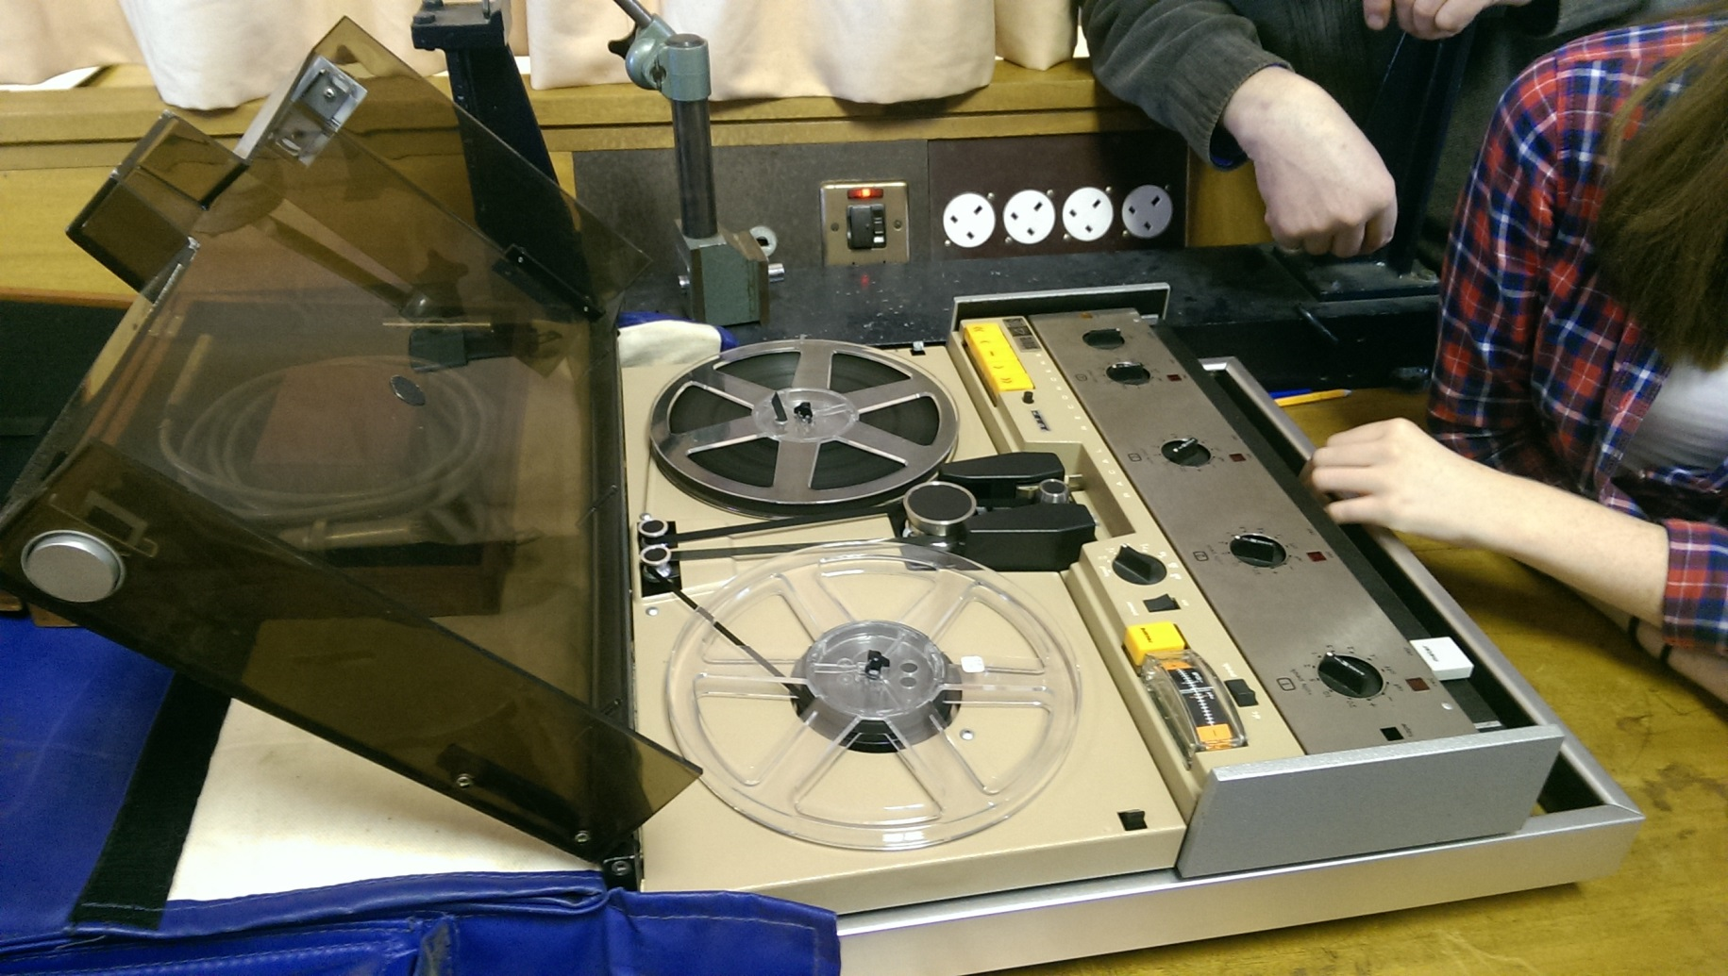
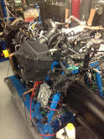
Investigations
Sound recorders
and Engine
testing

Slide 10
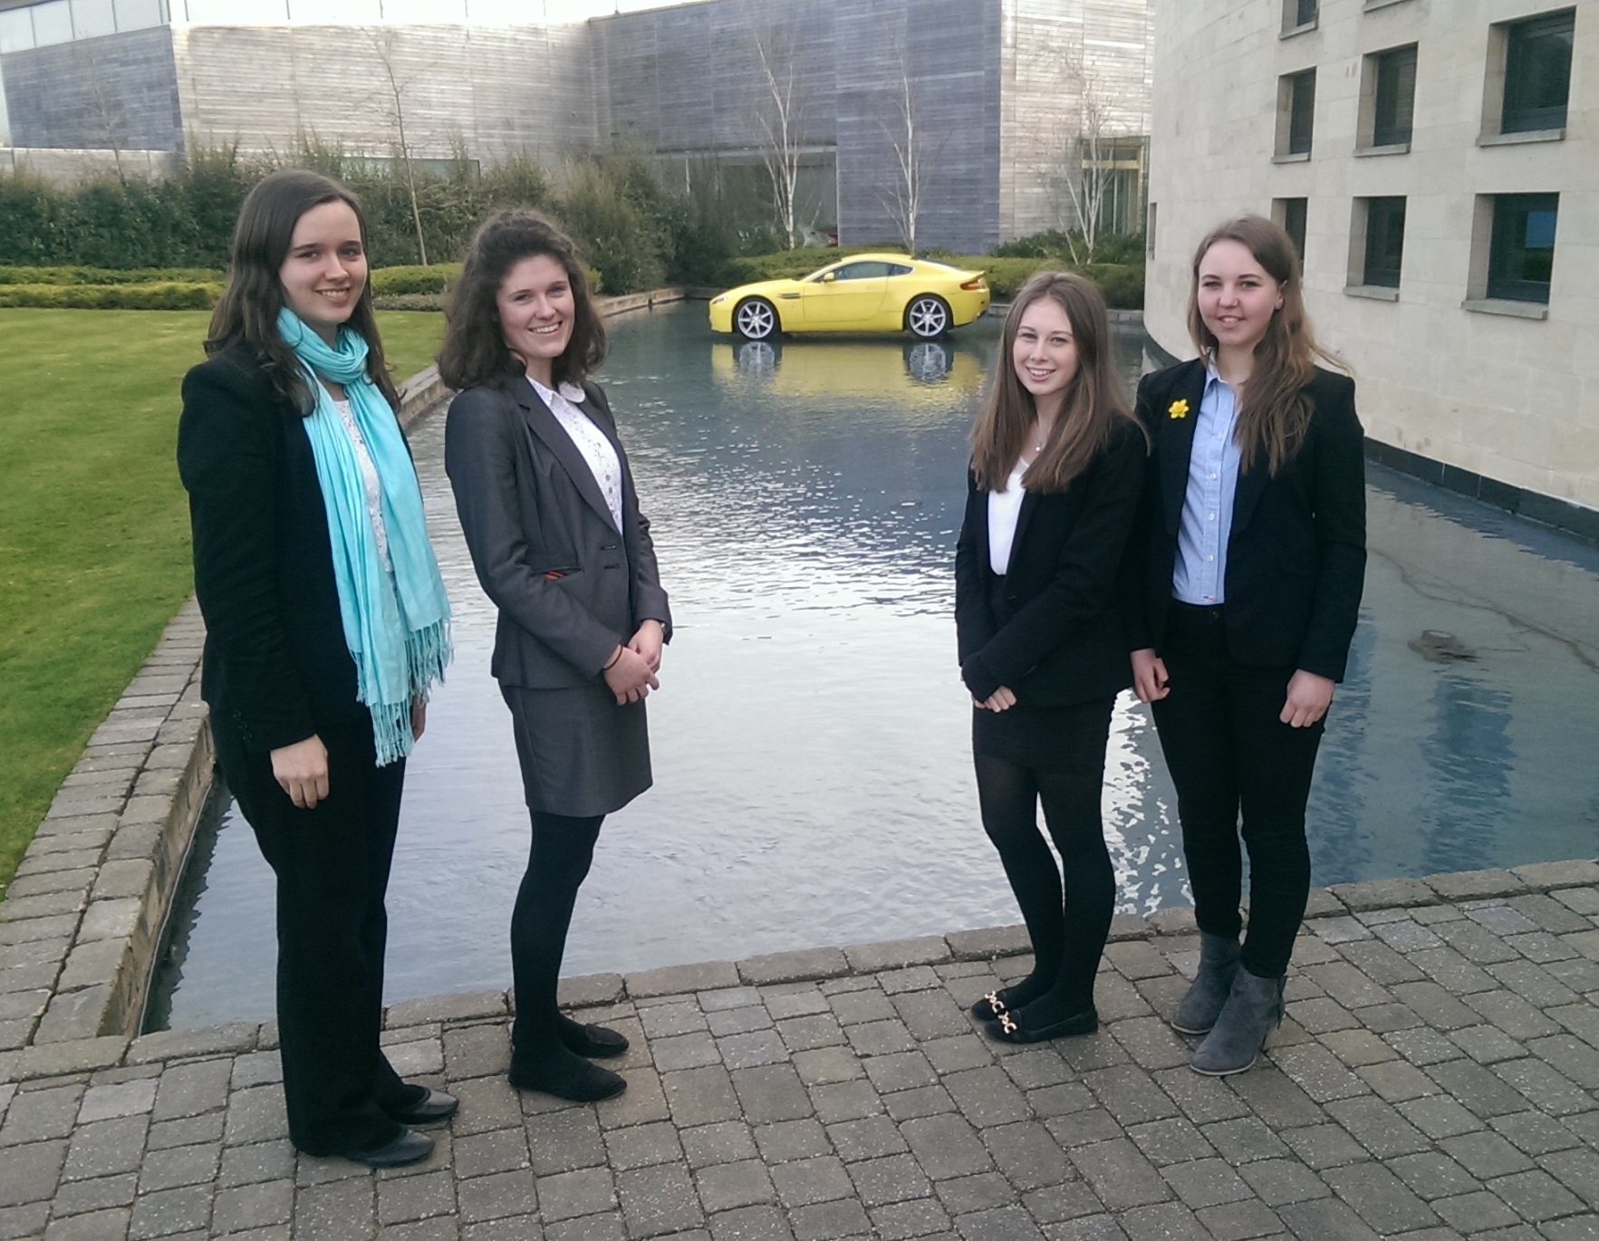
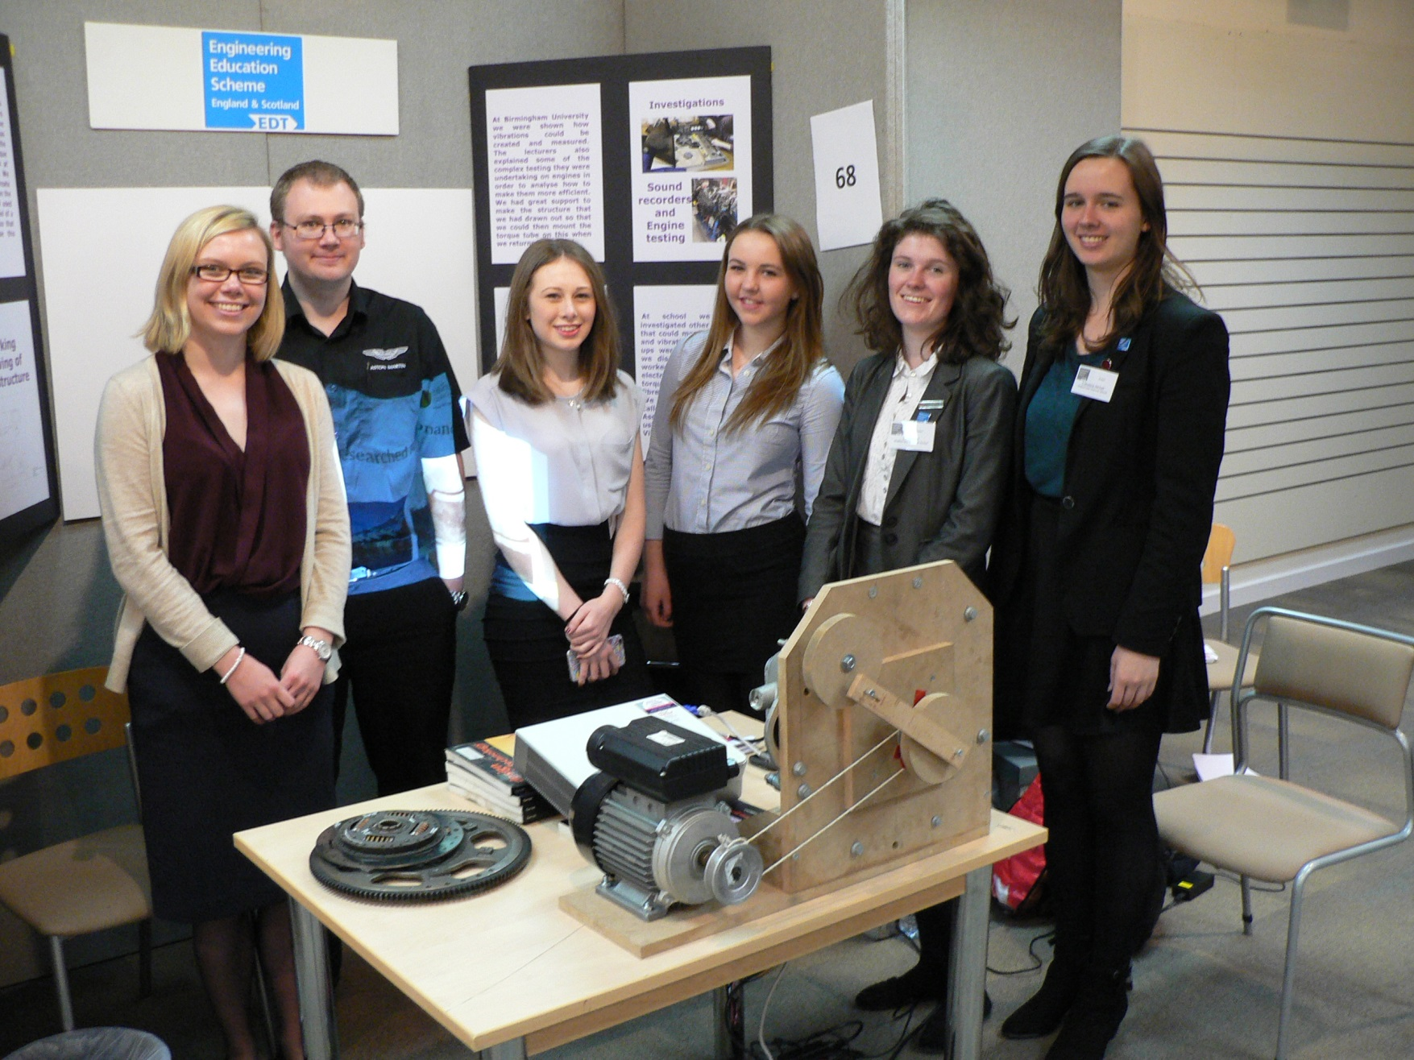

Slide 11
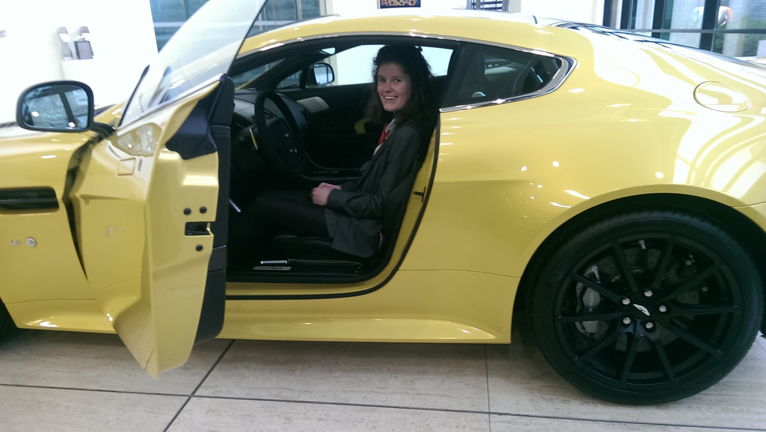
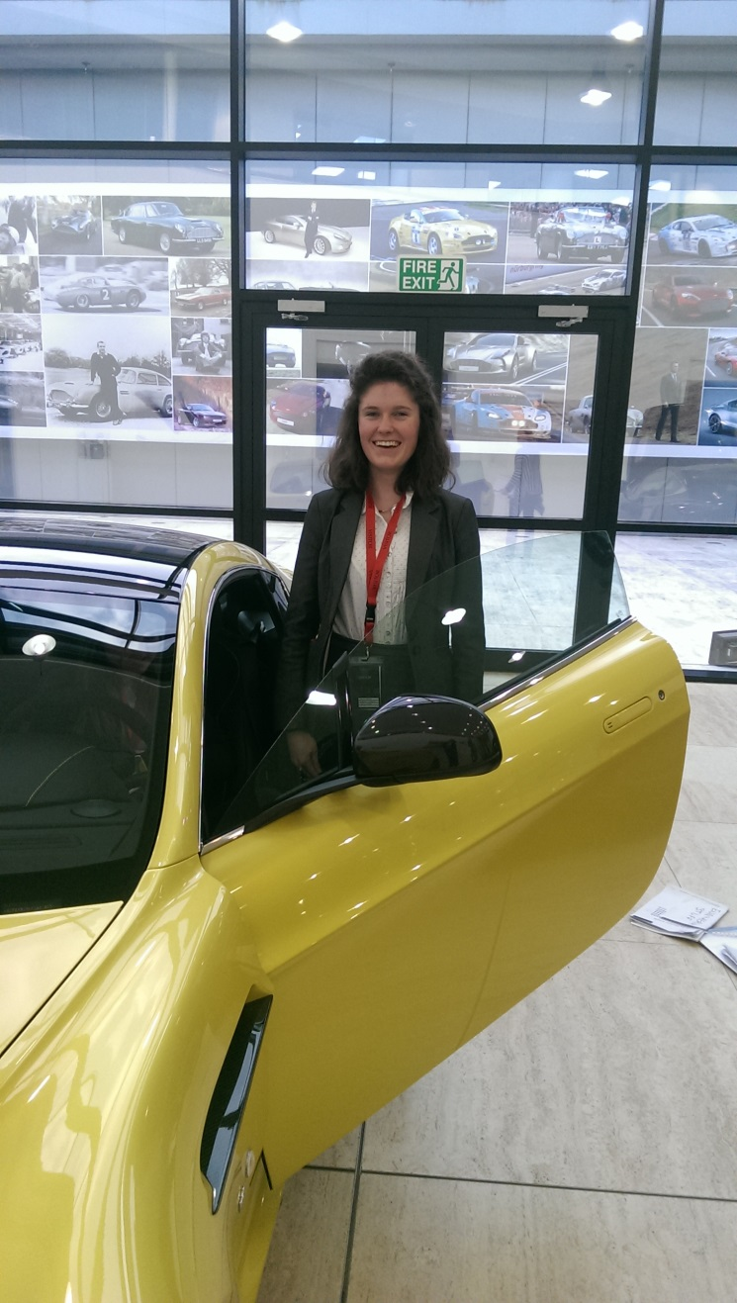

Slide 12


